Slide 1

Malaviya National Institute of Technology Jaipur
Presentation
on
IMAGE ENHANCEMENT UNDER IMAGE PROCESSING
Department of Electrical Engineering
SUBMITTED TO SUPERVISED BY Dr. Prerna Jain Dr. Hemant Kumar Meena Associate Professor Associate Professor | SUBMITTED BY Aryan Akshyadeep 2022UEE1335

Slide 2
Table of Contents
Introduction
Methodology
Implementation
Real Life Applications
Challenges Faced
Future Decisions
Conclusion
Reference

Slide 3
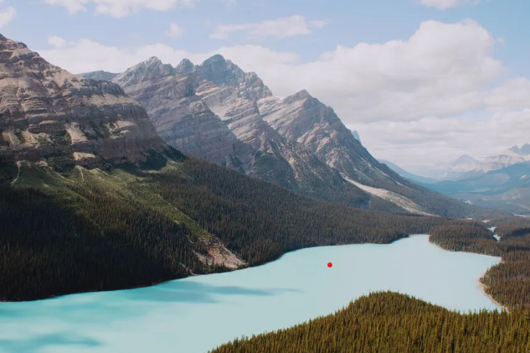
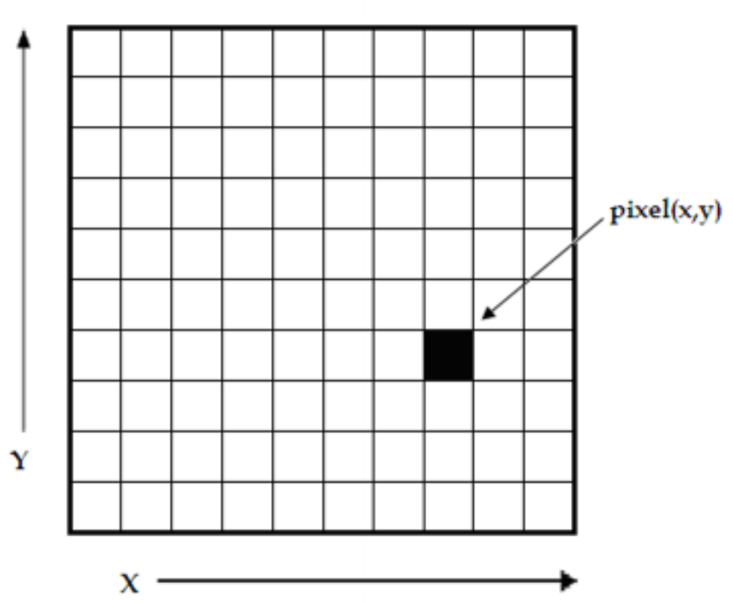
Introduction
An image is can be considered a two-dimensional array of tiny squares called pixels (picture elements). These pixels hold information about the color or intensity of the image at that specific location.
Each pixel contributes to the overall visual appearance of the image. By manipulating these pixels, we can perform various image processing tasks like enhancing colors, sharpening details, or even extracting information from the image.

Slide 4
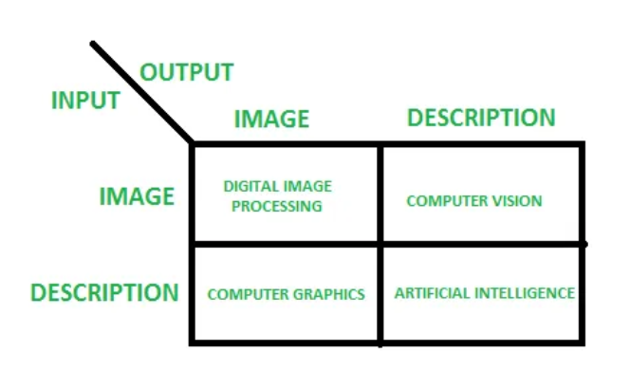
Introduction
Image processing is the field that deals with manipulating digital images using computer algorithms. It's essentially using computers to analyze and alter images in various ways.

Slide 5
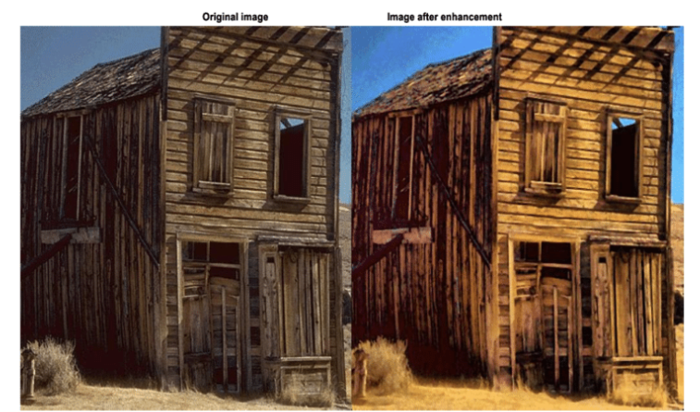
Introduction
Image enhancement is the process of manipulating a digital image to improve its visual quality or make it more suitable for a specific application.
This can involve techniques like:
Adjusting contrast and brightness: Making the image details more visible.
Removing noise: Eliminating unwanted artifacts that distort the image.
Sharpening edges: Increasing the definition of fine details.
Color correction: Balancing or modifying the color tones.

Slide 6
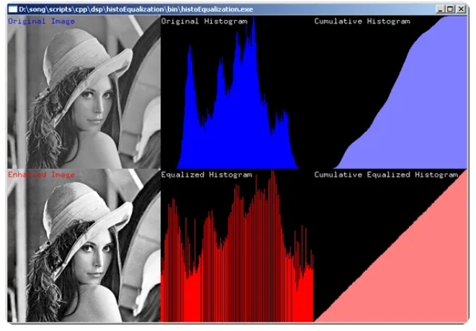
Methodology
Histogram Equalization:
Histogram equalization is a technique in image processing that improves image contrast by manipulating the intensity distribution of pixels.
In low-contrast images, the pixels cluster around a narrow range of intensities. Histogram equalization stretches this distribution, using the entire intensity range more evenly.
This process enhances contrast, making details in the image more visible.

Slide 7
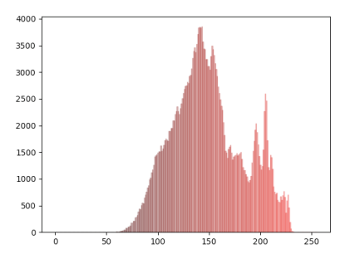
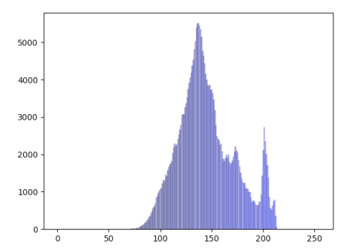
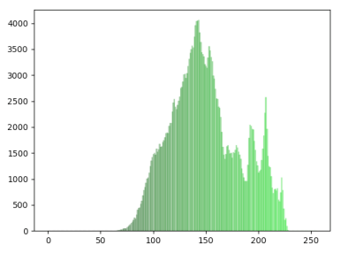
Methodology
Benefits of Histogram Equalization
• Improves visual quality, especially in low-contrast images.
• Makes details more prominent.
• Broadens the apparent dynamic range of the image.
Things to consider:
Can introduce noise in some cases.
May affect colour balance if applied to colour images (convert to grayscale first).

Slide 8
Methodology
2. Spatial Domain Enhancement:
Spatial domain enhancement techniques modify image pixels directly to improve visual quality.
Filtering and masking are two common methods for local contrast enhancement.
Filtering: A small mask (filter) slides across the image. Pixel values within the mask are averaged (mean filter) or manipulated (e.g., median filter) to create a new intensity value for the centre pixel. This can sharpen edges or reduce noise depending on the filter type.

Slide 9
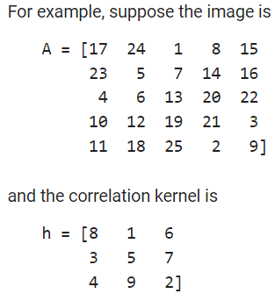
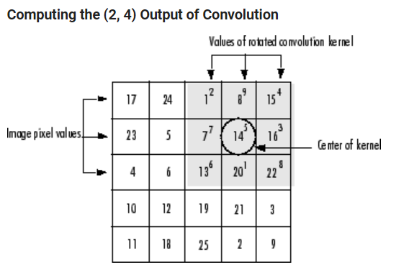
Methodology
Filtering using convolution:
Convolution is a neighborhood operation in which each output pixel is the weighted sum of neighboring input pixels. The matrix of weights is called the convolution kernel, also known as the filter. A convolution kernel is a correlation kernel that has been rotated 180 degrees.

Slide 10
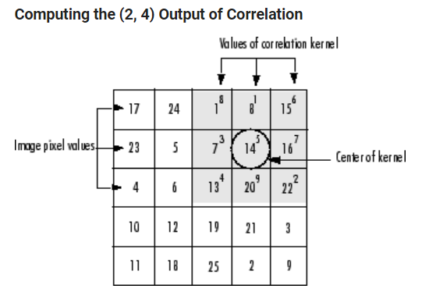
Methodology
Filtering using correlation:
The operation called correlation is closely related to convolution. In correlation, the value of an output pixel is also computed as a weighted sum of neighboring pixels. The difference is that the matrix of weights, in this case called the correlation kernel, is not rotated during the computation.

Slide 11
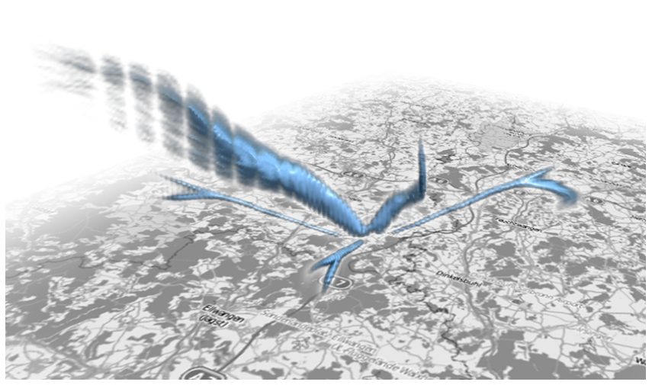
Methodology
Masking: Here, a separate mask defines the region of interest. The image is filtered only within this mask, enhancing contrast in specific areas while preserving details elsewhere. Unsharp masking is a popular example where a blurred version of the image is subtracted from the original, highlighting sharpened edges.

Slide 12
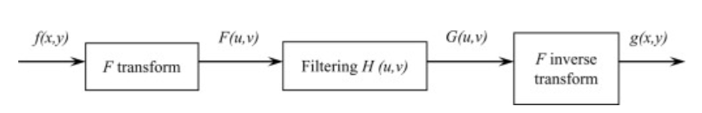
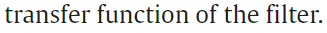
Methodology
3. Frequency Domain Enhancement:
Frequency domain enhancement utilizes the Fourier transform to manipulate an image's frequency components for targeted manipulation.
Images in the spatial domain (normal view) are converted to the frequency domain, where information is represented by frequency and intensity.

Slide 13
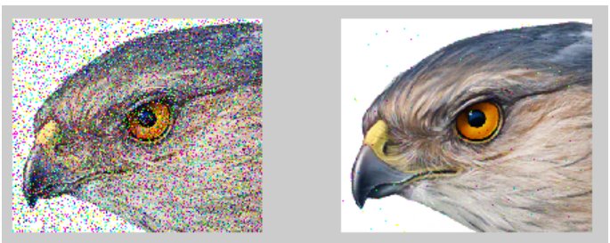
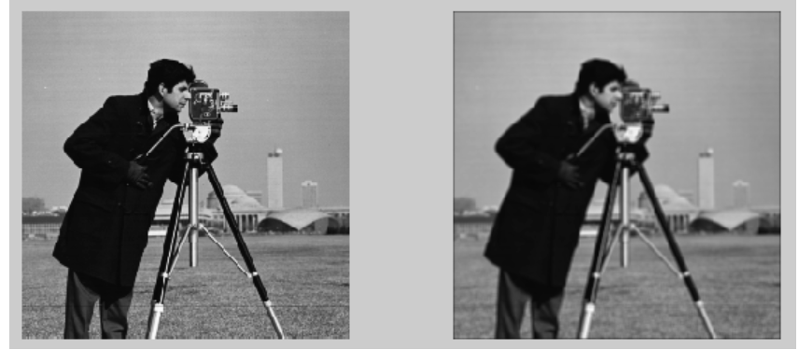
Methodology
High-Pass Filtering (Sharpening): Boosts high frequencies, sharpening edges and details.
Low-Pass Filtering (Smoothing): Suppresses high frequencies, reducing noise and blurring details.

Slide 14


Implementation
We have till now seen the methodologies used in the enhancement of images.
We now will see, the implementation of the mentioned methodologies in various platforms, commonly used being Python and MATLAB.

Slide 15
Implementation
Showing the codes (MATLAB) for executing low-pass frequency:
Y = filter2(h,X)
Y = filter2(h,X,shape)
img = imread('cameraman.tif');
imgd = im2double(img); % imgd in [0,1]
f = ones(3,3)/9;
img1 = filter2(f, imgd);
subplot(121);imshow(img);
subplot(122);imshow(img1);

Slide 16
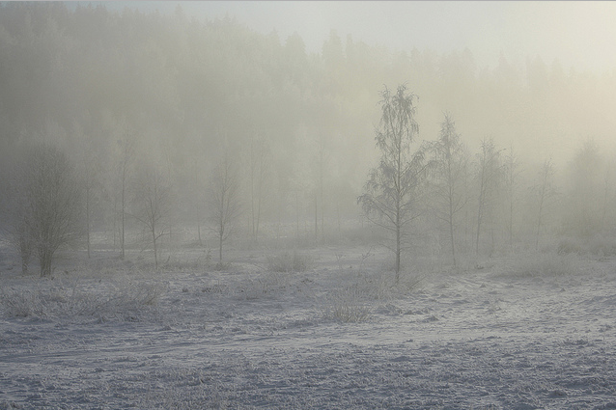
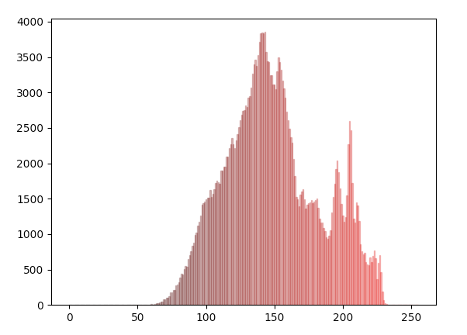
Implementation
Showing the codes (Python) for executing Contrast Stretching:
# Example Python Program for contrast stretching
from PIL import Image
# Method to process the red band of the image
def normalizeRed(intensity):
iI = intensity
minI = 86
maxI = 230
minO = 0
maxO = 255
iO = (iI-minI)*(((maxO-minO)/(maxI-minI))+minO)
return iO

Slide 17

Implementation
# Method to process the green band of the image
def normalizeGreen(intensity):
iI = intensity
minI = 90
maxI = 225
minO = 0
maxO = 255
iO = (iI-minI)*(((maxO-minO)/(maxI-minI))+minO)
return iO

Slide 18
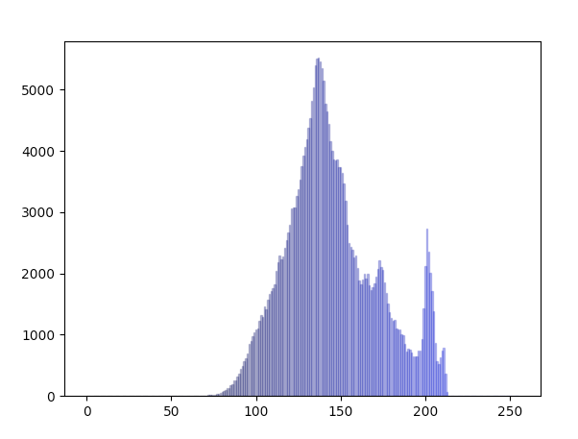
Implementation
# Method to process the blue band of the image
def normalizeBlue(intensity):
iI = intensity
minI = 100
maxI = 210
minO = 0
maxO = 255
iO = (iI-minI)*(((maxO-minO)/(maxI-minI))+minO)
return iO

Slide 19
Implementation
# Create an image object
imageObject = Image.open("./glare4.jpg")
# Split the red, green and blue bands from the Image
multiBands = imageObject.split()
# Apply point operations that does contrast stretching on each color band
normalizedRedBand = multiBands[0].point(normalizeRed)
normalizedGreenBand = multiBands[1].point(normalizeGreen)
normalizedBlueBand = multiBands[2].point(normalizeBlue)

Slide 20
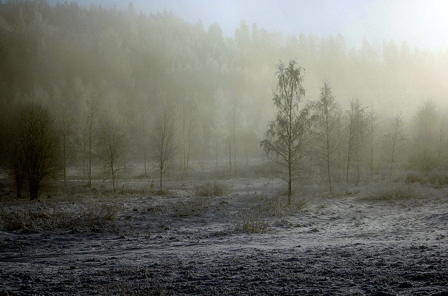
Implementation
# Create a new image from the contrast stretched red, green and blue brands
normalizedImage = Image.merge("RGB", (normalizedRedBand, normalizedGreenBand, normalizedBlueBand))
# Display the image before contrast stretching
imageObject.show()
# Display the image after contrast stretching
normalizedImage.show()

Slide 21
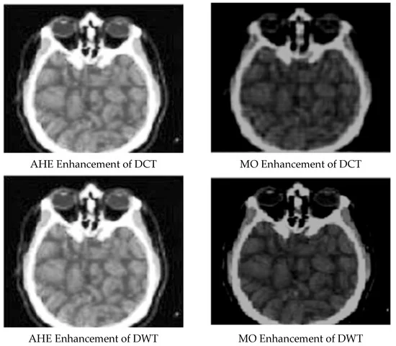
Real Life Applications
Medical Industry:
Image enhancement is a crucial process in the medical field that refines medical images to improve a doctor's ability to diagnose and treat patients. These enhancements can:
Increase contrast between tissues and organs
Sharpen edges to make boundaries clearer
Reduce noise to improve image clarity
By enhancing medical images, doctors can more confidently:
Detect tumors and other abnormalities
Monitor treatment progress
Plan surgeries

Slide 22
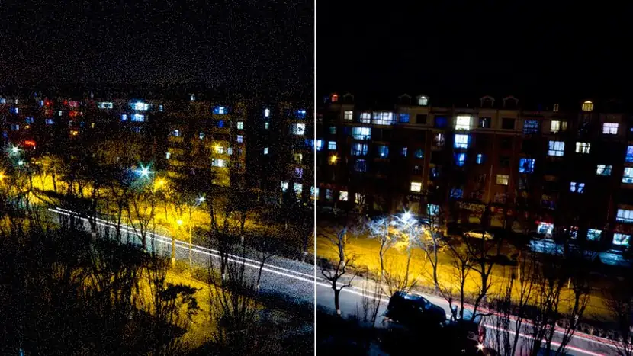
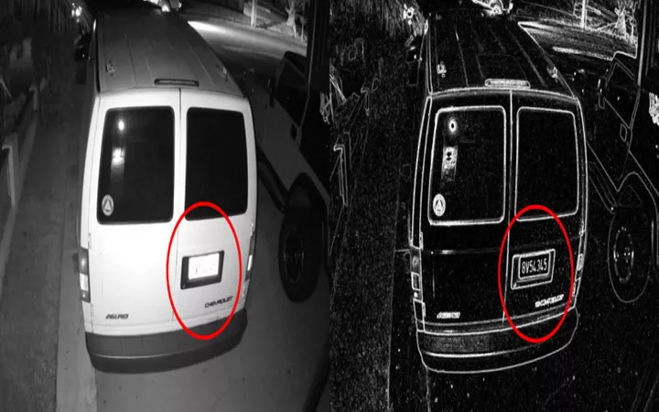
Real Life Applications
2. Surveillance and Security Systems:
Image enhancement plays a crucial role in improving the quality of footage captured by surveillance cameras, allowing for better identification of objects and people.
Low-light enhancement: Brightens images captured in poor lighting conditions, revealing details obscured by darkness.
Noise reduction: Eliminates grainy static from footage, improving clarity.
Sharpening: Enhances edges and outlines, making objects and faces more recognizable.

Slide 23
Real Life Applications
By enhancing surveillance images, one can see the following results
Improved identification: Clearer visuals enable better identification of suspects, victims, and vehicles.
Enhanced evidence collection: Provides higher quality footage for forensic analysis.
Better situational awareness: Enables security personnel to assess situations more accurately.

Slide 24
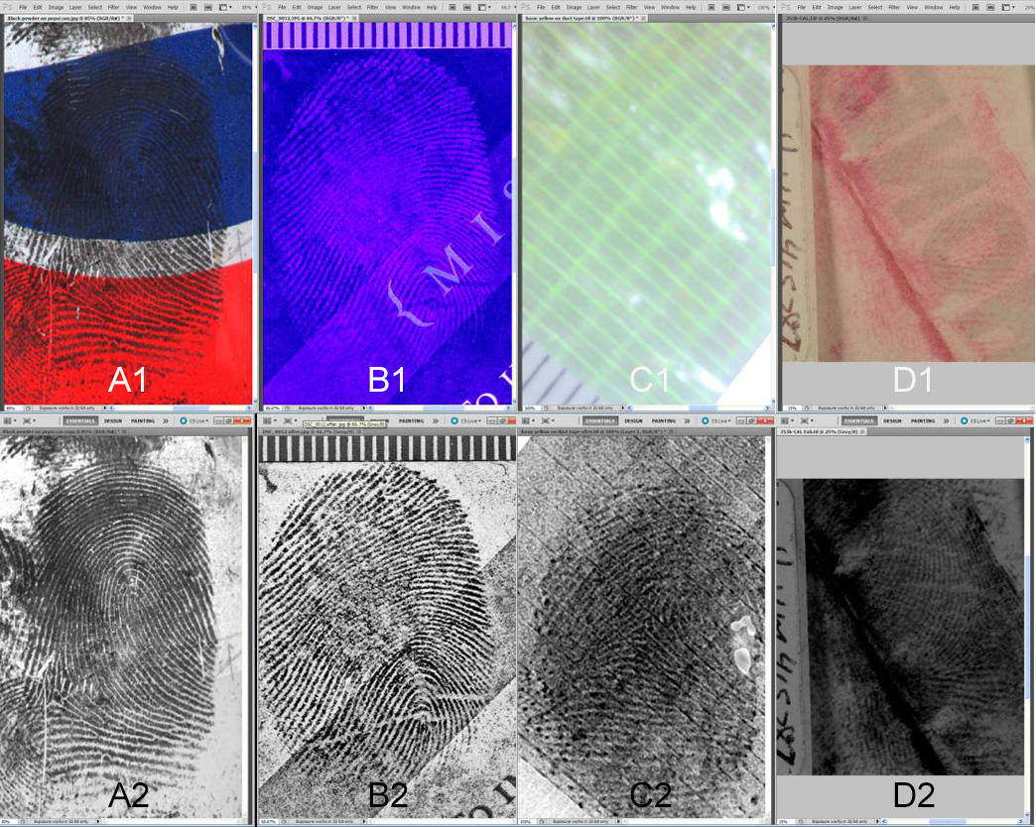
Real Life Applications
3. Forensics:
Image enhancement is a crucial process in forensic studies that helps investigators extract more information from visual evidence.
Improves Clarity: Image enhancement techniques can sharpen blurry images, adjust contrast in poorly lit areas, and reduce noise, making crucial details like faces, license plates, or fingerprints clearer for analysis.
Reveals Hidden Details: Sometimes, important evidence might be hidden in shadows or obscured by glare. Enhancement can bring out these details, potentially leading to new investigative avenues.
Aids in Identification: Enhanced images can help investigators identify suspects, victims, objects, or even locations depicted in the image.
Verification of Authenticity: Image enhancement can also be used to detect signs of tampering or manipulation in digital evidence.

Slide 25
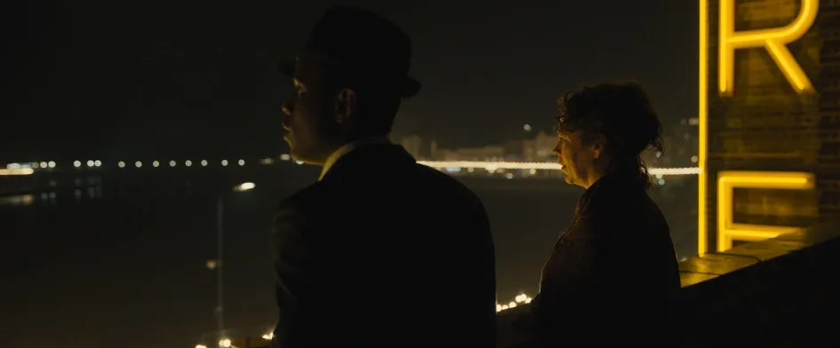
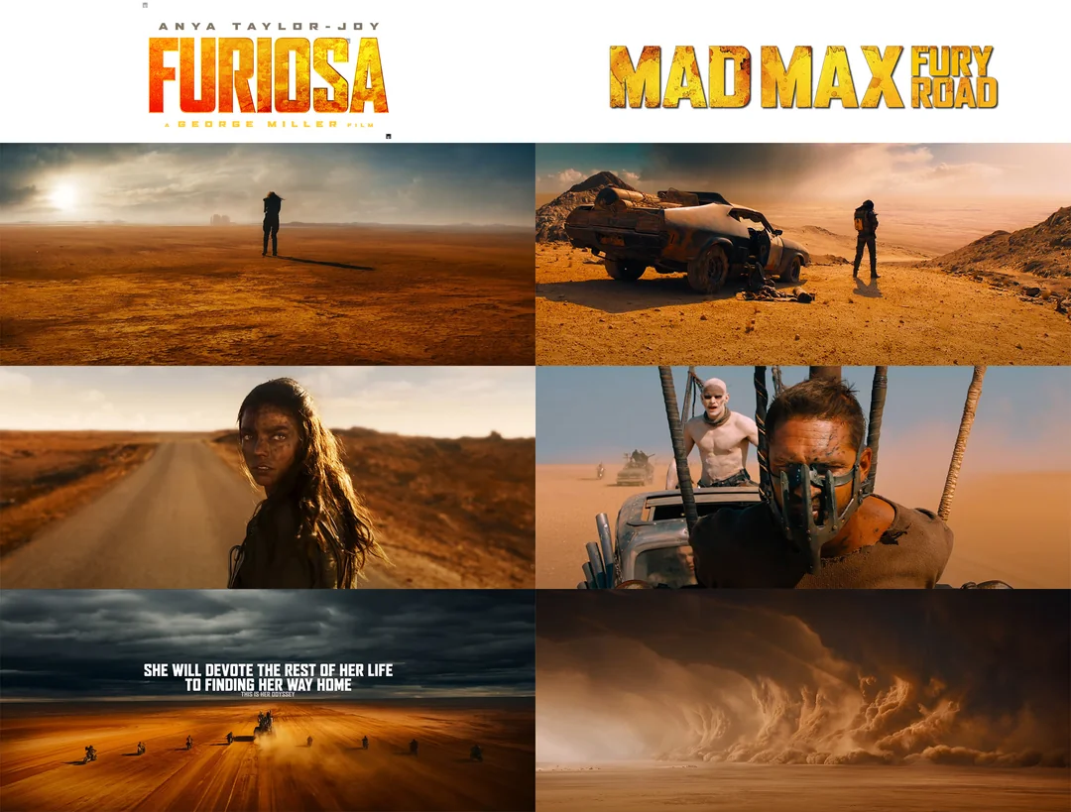
Real Life Applications
4. Movie and Cinema Industry:
Image enhancement is a crucial part of the movie making process, used in both filming and post-production.
Corrects lighting issues: Improves the quality of shots where lighting might have been uneven or unfavorable during filming.
Color Grading: Creates a specific mood or atmosphere by adjusting colors, brightness, and contrast.

Slide 26
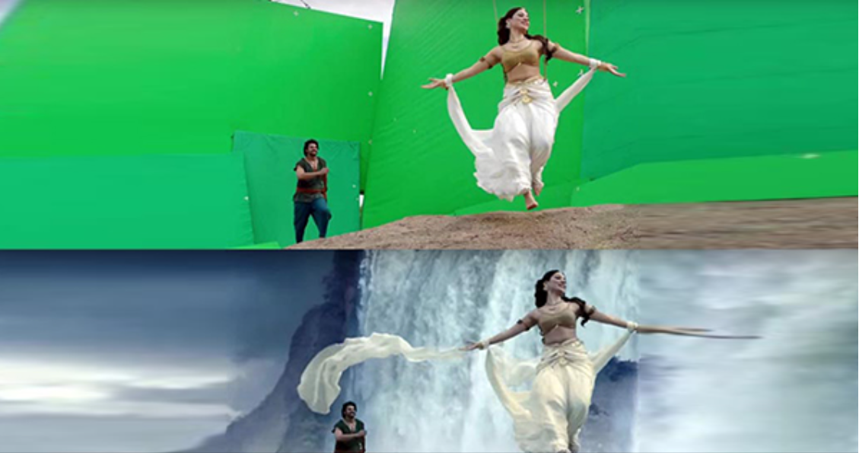
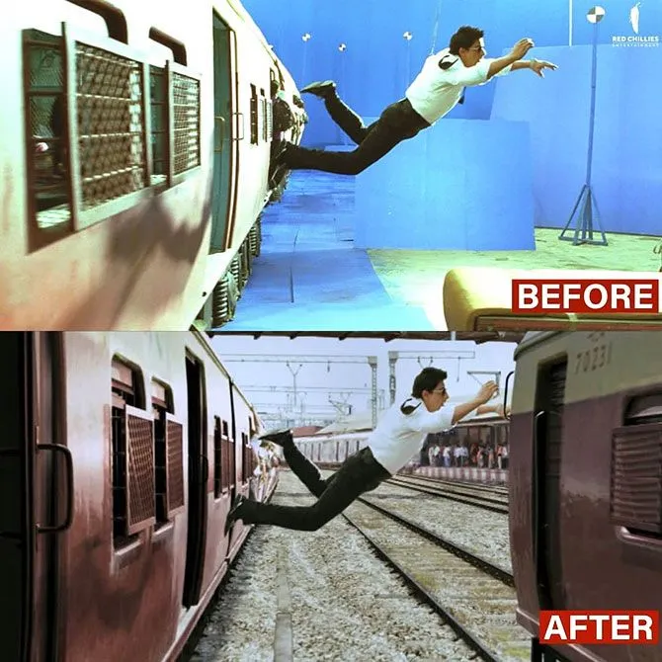
Real Life Applications
Visual Effects (VFX): Allows for seamless integration of computer-generated imagery (CGI) with real footage.
Restoration of older films: Breathes new life into classic movies by removing scratches, dirt, and other imperfections.

Slide 27
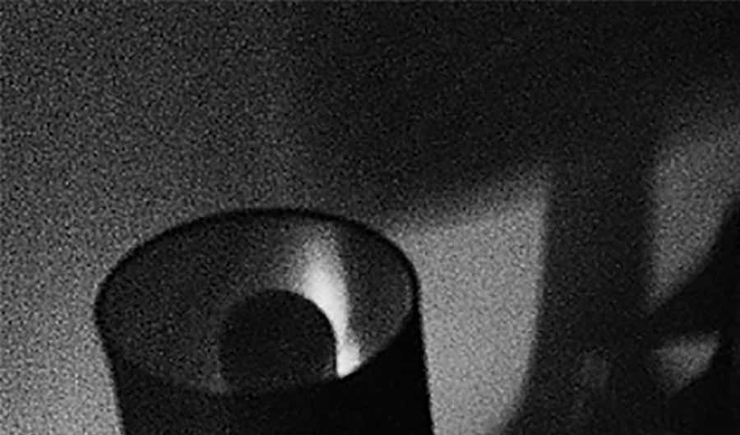
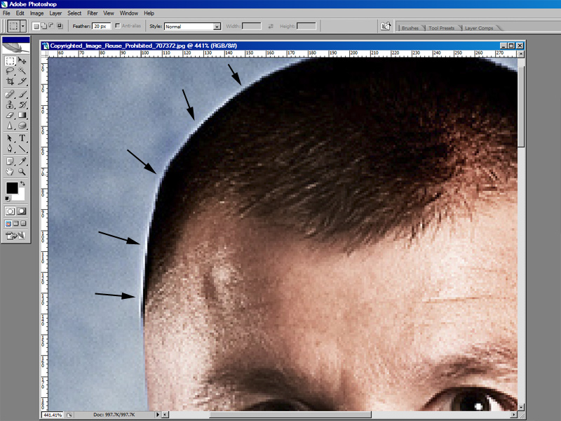
Challenges Faced
Noise Reduction: Removing unwanted grain or static from an image without affecting the important details can be tricky.
Balancing Sharpening and Artifacts: Sharpening an image to increase clarity, but avoiding creating halos or unnatural edges

Slide 28
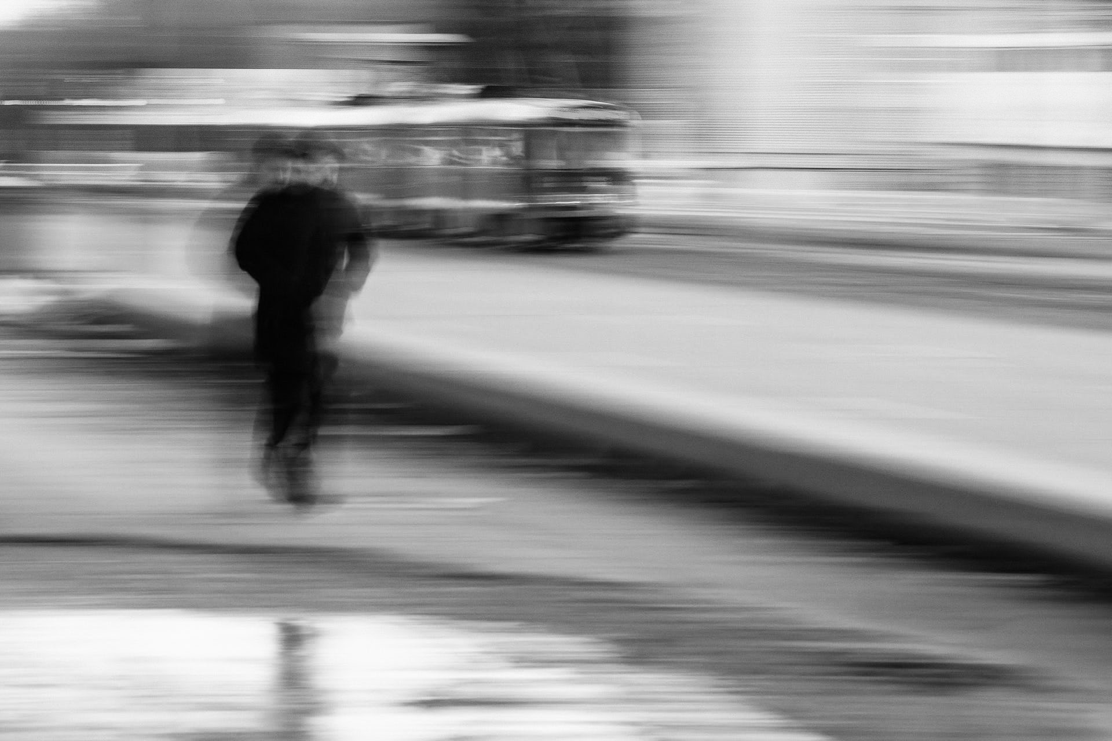
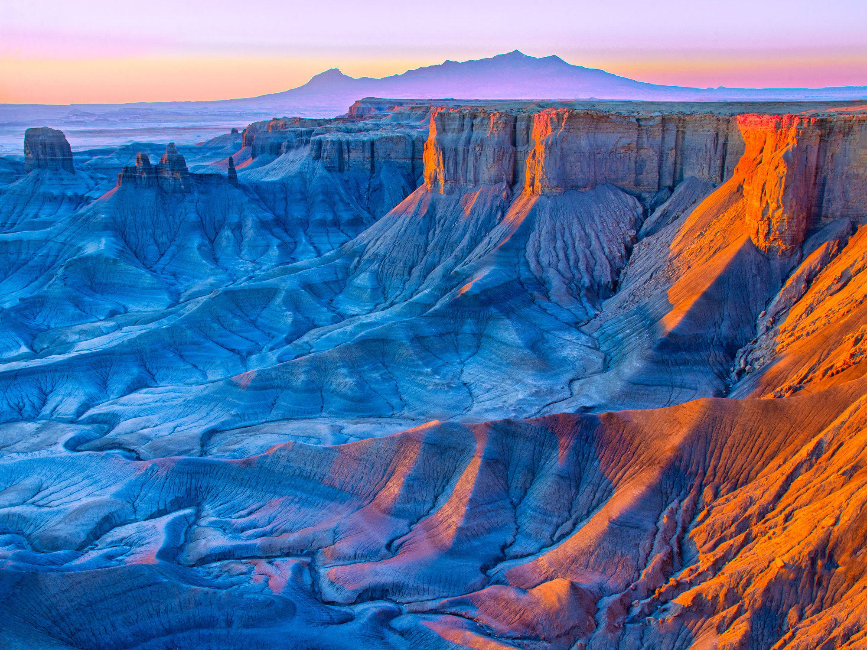
Challenges Faced
Loss of Detail: Some enhancements, like noise reduction, can blur details in an image.
Subjectivity of Enhancement: What looks better can be a matter of personal preference.

Slide 29
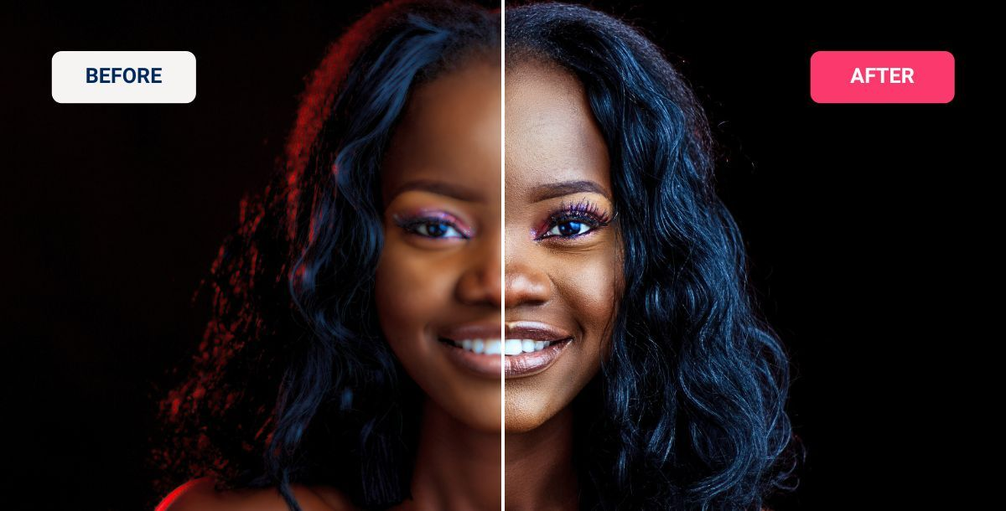

Future Decisions
AI-powered Enhancements: Machine learning and artificial intelligence will play an increasingly important role in image enhancement. AI algorithms will be able to learn from vast amounts of data to automatically identify and correct image problems, such as noise, blur, and low resolution.
Content Creation: Image enhancement tools will be used to create entirely new images, rather than simply improve existing ones. This could be used to generate realistic images for use in movies, video games, or other creative applications.

Slide 30
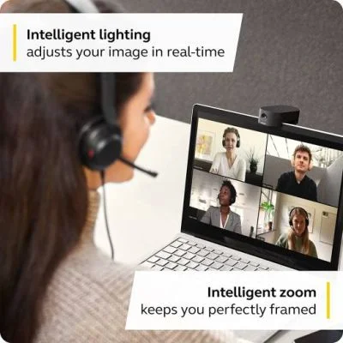
Future Decisions
Real-time enhancement: Image enhancement will be possible in real-time. This will allow for applications such as improving the quality of video conferencing and live streaming.
Focus on semantic understanding: Image enhancement tools will begin to incorporate a deeper understanding of the content of an image. This will allow them to make more intelligent decisions about how to enhance the image. For example, an image enhancement tool could identify the subject of an image and selectively enhance it.

Slide 31
Conclusion
Image enhancement is like applying makeup to a digital image.It modifies a digital image to make it look better or to provide more clarity for specific purposes.
It improves the visual quality of a picture by adjusting things like brightness, contrast, and sharpness.
This can make an image more aesthetically pleasing or easier to analyze by a computer program.
The goal can be to improve aesthetics, prepare an image for analysis by a computer, or to recover lost details.

Slide 32
References
[1] Lyra, Maria & Ploussi, Agapi & Georgantzoglou, Antonios. (2011). MATLAB as a Tool in Nuclear Medicine Image Processing. 10.5772/19999. https://www.researchgate.net/figure/A-digital-image-is-a-2D-array-of-pixels-Each-pixel-is-characterised-by-its-x-y_fig1_221918148
[2] GeeksforGeeks: Digital Image Processing Basics
https://www.geeksforgeeks.org/digital-image-processing-basics/
[3] Gazal, Oluwakemi & Adedokun, Emmanuel & Umoh, Ime & Momoh, Omuya & Momoh, Muyideen. (2020). LWT-CLAHE Based Color Image Enhancement Technique: An Improved Design. Computer Engineering and Applications Journal. 9. 117-126. 10.18495/comengapp.v9i2.329.
https://www.researchgate.net/figure/Original-image-versus-Enhanced-image-Bodie_fig1_341914541
[4] Songho.Ca: Histogram and Histogram Equalization
http://www.songho.ca/dsp/histogram/histogram.html
[5] MathWorks: Image Filtering in the Spatial Domain
https://www.bogotobogo.com/Matlab/Matlab_Tutorial_Digital_Image_Processing_6_Filter_Smoothing_Low_Pass_fspecial_filter2.php
[6] Buschmann, Stefan & Trapp, Matthias & Döllner, Jürgen. (2012). Challenges and Approaches for the Visualization of Movement Trajectories in 3D Geovirtual Environments.
https://www.researchgate.net/figure/3D-trajectory-visualization-with-and-without-unsharp-masking-effect_fig6_303836352

Slide 33
References
[7] BogoToBogo: MATLAB TUTORIAL : DIGITAL IMAGE PROCESSING 6 - SMOOTHING : LOW PASS FILTER
https://www.bogotobogo.com/Matlab/Matlab_Tutorial_Digital_Image_Processing_6_Filter_Smoothing_Low_Pass_fspecial_filter2.php
[8] ScienceDirect: Video Enhancement and Restoration,Reginald L. Lagendijk, ... Marcel J.T. Reinders, in The Essential Guide to Video Processing, 2009
https://www.sciencedirect.com/topics/engineering/spatial-domain-method
[9] A Novel Image Processing Approach to Enhancement and Compression of X-ray Images, by Yaghoub Pourasad and Fausto Cavallaro
https://www.mdpi.com/1660-4601/18/13/6724
[10] Explaining Digital Noise Reduction (DNR) In Security Cameras by Austin Leavitt, September 7, 2018.
https://getsafeandsound.com/2018/09/2d-3d-noise-reduction-security-cameras/
[11] Metrics for Manipulation and Enhancements of Forensic Images by Andrew Dienstfrey, Mary Frances Theofanos, Peter Bajcsy, Joe Chalfoun, Alfred S Carasso.
https://www.nist.gov/programs-projects/metrics-manipulation-and-enhancements-forensic-images

Slide 34
Thank You

